Slide 1

Hotel aggregator Power-Bi Dashboard
By Muhammed Zidan
Notes:
Hello and welcome to mentoness Hotel aggregator Power-Bi Dashboard by Muhammed Zidan

Slide 2
Table of contents
01
02
03
04
What is the project
Objectives and dataset
Discussion and Dashboard
Conclusions and Insights
Notes:
In this presentation, we are going to discuss What this project is, the Objectives, the dataset, the Dashboard, the Conclusions and the Insights.

Slide 3
What is this project?
The project offers interns a dynamic learning experience through the utilization of Power BI, enabling students to delve into the intricacies of hotel aggregator listings. Through interactive Power BI dashboards, interns explore the geographical spread, pricing dynamics, host attributes, and review ratings, gaining a comprehensive understanding of the market landscape.
Notes:
The project enables students to dive into the dataset of hotel aggregator listings Through interactive Power BI dashboards. interns explore the geographical spread, pricing dynamics, host attributes, and review ratings, gaining a comprehensive understanding of the market landscape.

Slide 4
Objectives and dataset
The project analyzes a rental platform's data to create interactive Power BI dashboards showing geographical distribution, pricing trends, host characteristics, and review scores. Reports detail availability patterns, property preferences, and factors influencing guest satisfaction, with recommendations for hosts and the platform.
Goals include understanding geographical insights, pricing dynamics, host performance, review scores impact, and property analysis to enhance platform performance and user satisfaction.
Notes:
The project analyzes a rental platform's data to create interactive Power BI dashboards showing geographical distribution, pricing trends, host characteristics, and review scores.

Slide 5
Objectives and dataset
The dataset comprises various attributes related to listings, hosts, reviews, and availability. The objective is to create comprehensive visualizations and insights that shed light on trends, patterns, and factors influencing the performance of listings.
Dataset Description:
1. id: Unique identifier for each listing.
2. listing_url: URL of the listing.
3. scrape_id: Identifier for the data scraping event.
4. last_scraped: Date of the last data scrape.
5. source: Source of the listing information.
6. name: listing name and some attributes of the listing.
7. description: Description of the listing.
8. ... (and many more columns capturing details about hosts, location, property type, room details, amenities, pricing, availability, reviews, and other relevant information)
Notes:
The dataset comprises various attributes related to listings, hosts, reviews, and availability like:
1. name: listing name and some attributes of the listing.
2. source: Source of the listing information.
and many more columns capturing details about hosts, location, property type, room details, amenities, and so on.

Slide 6
Discussion and Dashboard
To create the dashboard, students should load and handling the dataset like:
Removing unused columns like listing_url, neighborhood_overview, and so on.
Check the duplicated rows using the unique identifiers of the table.
Split and handle some columns like "Hostlocation" and "name" columns to create more effective columns.
Correct the structure errors like in “host_response_rate”, “review_scores_rating” columns.
Creating calculated columns using DAX like "HostMegred”,” CleanOverAllRating” columns
Notes:
To create the dashboard, students should load and handling the dataset like:
Removing unused columns
Check the duplicated rows
Split and handle some columns
Correct the structure errors
Creating calculated columns using DAX

Slide 7
Discussion and Dashboard
Some Simple DAX examples: 1- host_email = IF(CONTAINSSTRING('Hotel Aggregator dataset'[host_verifications],"email"),
"Yes",
"No“)
2- CleanOverAllRating =
IF(ISBLANK('Hotel Aggregator dataset'[StarRating]),
'Hotel Aggregator dataset'[review_scores_rating],
'Hotel Aggregator dataset'[StarRating])
Notes:
Here is some DAX examples
1- Host_email is no check if the host has an E-mail
2- cleanOverAllRating is to get all the clean and accurate rating as it was spited in a different columns

Slide 8
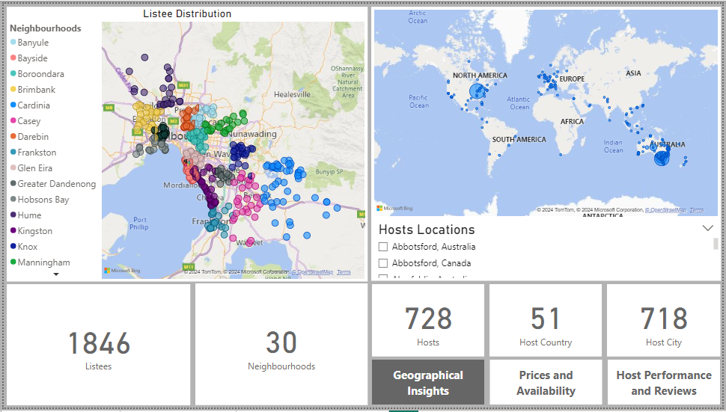
Discussion and Dashboard
Geographical Insights: we can check visually map listing distributions to pinpoint popular neighbourhoods and delve into geographical concentration to understand listing and host placements.
Notes:
In this sheet, we can check the distributions to pinpoint popular neighbourhoods and hosts locations.

Slide 9
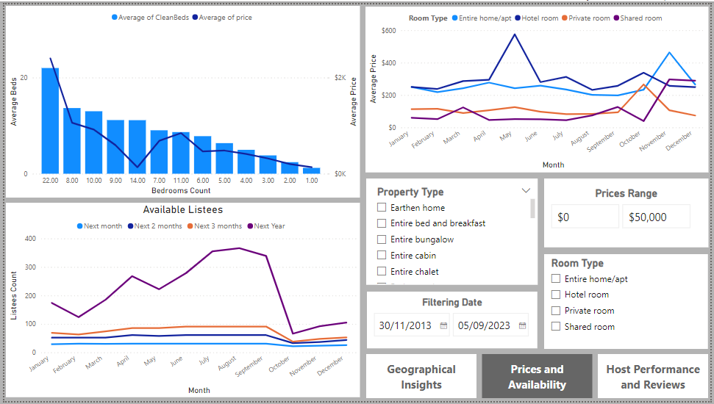
Discussion and Dashboard
Prices and Availability: we scrutinize pricing patterns across various property and room types, and accommodation capacities. They further delve into listing availability trends over time, pinpointing peak periods of demand.
Notes:
In this one we can see the of prices and availability across various property and room types, capacities and peak periods of demand.

Slide 10
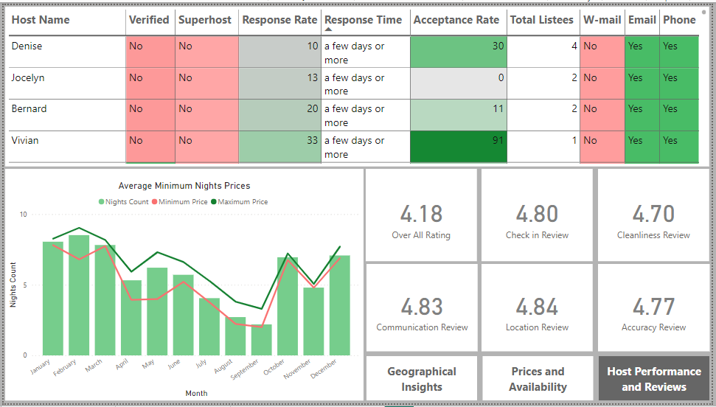
Discussion and Dashboard
Host Performance and Reviews: we delve into review scores, assessing their influence on listing performance, and pinpoint areas for enhancement through detailed review category analysis.
Notes:
And in this sheet, we delve into review scores, assessing their influence on listing performance, and pinpoint areas for enhancement through detailed review category analysis.

Slide 11
Conclusions and Insights
1- The city with the most listings is Melbourne, Australia, with 800 listings spread across 30 neighborhoods.
2- The highest availability of listings occurred in March 2020, January, April, and August 2023, for durations of 30, 60, 90, and 360 days, respectively.
3- The more bedrooms you order, the higher the price, but ordering 14 bedrooms can yield significantly lower prices in many places.
4- From 2018 to 2022, shared and private rooms have been competitors, with shared rooms being cheaper most of the time. However, the most sought-after property type throughout this period has been entire homes.
5- Factors influencing guest satisfaction include cleanliness, amenities, communication, and overall experience.
Notes:
As a conclusion, Melbourne, Australia, tops the charts with 800 listings in 30 neighborhoods. Peak availability occurred in specific months from 2020 to 2023. Ordering 14 bedrooms can surprisingly lead to lower prices. Shared rooms were often cheaper than private ones, but entire homes remained the most desired. Guest satisfaction depends on cleanliness, amenities, communication, and overall experience.

Slide 12





Thanks You!
https://www.kaggle.com/muhammedzidan
https://www.linkedin.com/in/muhammed-zidan/
https://public.tableau.com/app/profile/muhammed1658
Muhammedzidan135@gmail.com
Please keep this slide for attribution
Notes:
And yeah that’s it. ;et me know if you need any questions.

